Slide 1
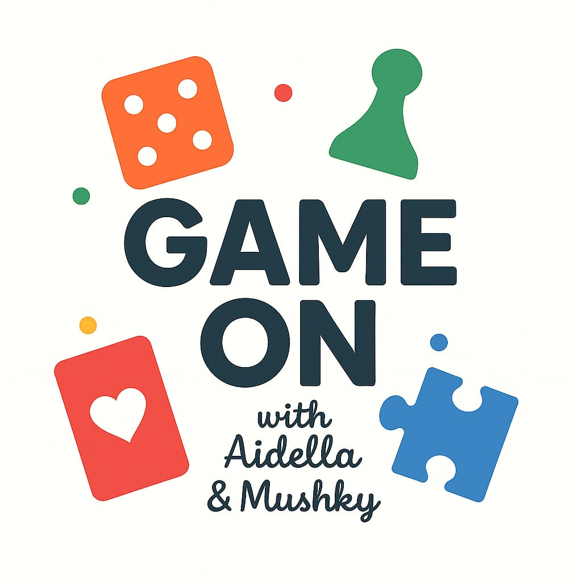

WOULD YOU RATHER?
Custard Donuts
Jelly Donuts

Slide 2
WOULD YOU RATHER?
Chanukah Gelt
Chanukah Presents

Slide 3
WOULD YOU RATHER?
Texts
calls

Slide 4
WOULD YOU RATHER?
Milchigs
Fleishigs

Slide 5
WOULD YOU RATHER?
Ice skating
Snow tubing

Slide 6
WOULD YOU RATHER?
Aim!
circle

Slide 7
WOULD YOU RATHER?
owala
sTanley

Slide 8
WOULD YOU RATHER?
Be the host
Be the guest

Slide 9
WOULD YOU RATHER?
New shaitel
New jewelry

Slide 10
WOULD YOU RATHER?
Sunday funday
Sunday chill-day

Slide 11
WOULD YOU RATHER?
Lose car keys
Lose cell phone

Slide 12
WOULD YOU RATHER?
Night owl
Early bird

Slide 13
WOULD YOU RATHER?
vacation
staycation

Slide 14
WOULD YOU RATHER?
sweet
savory

Slide 15
WOULD YOU RATHER?
Parking ticket
Call from your kid’s principal

Slide 16
WOULD YOU RATHER?
school
Summer vacation

Slide 17
WOULD YOU RATHER?
Cozy and casual
All Dressed up

Slide 18
WOULD YOU RATHER?
Shabbos dishes
Root canal

Slide 19
WOULD YOU RATHER?
Home cooked meals
Take out

Slide 20
WOULD YOU RATHER?
Dinner & Discussion
Family game
night!

